Slide 1

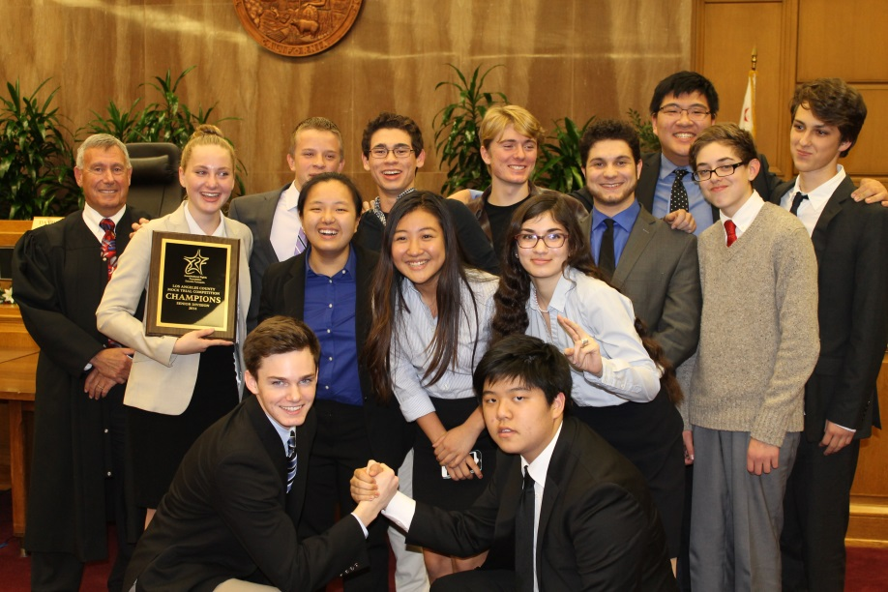
How To Prepare A Team For
Mock Trial
Presenters: Jean Wentz and Lourdes Morales
www.crf-usa.org
Notes:
1
So what’s this webinar all about? The name of this webinar is How to Prepare a Team for Mock Trial. This webinar is intended for coaches who are new to mock trial and are looking for an overview of how to prepare your team for the California Mock Trial Competition. Preparing a team for the mock trial competition may seem like a daunting task, particularly to those of you who are new to mock trial. The goal of this webinar is to provide some framework to you as you begin your preparations for your county competition.

Slide 2
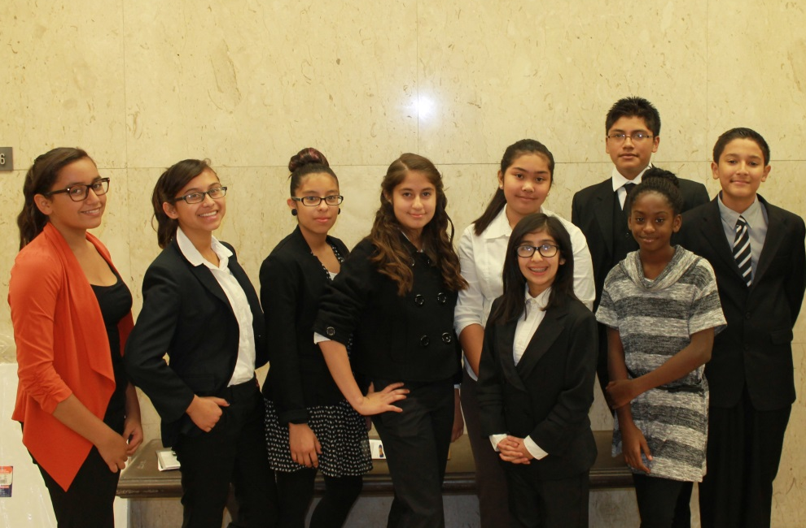
Field a Team
  A team must have at least 8, but no more than 25 members
  Some counties allow schools to field more than 1 team
www.crf-usa.org
Notes:
So, how do you get started? Well, the first thing to do is to field a team. Under the rules of the mock trial competition, a team must have at least 8, but no more than 25 student members, and that number includes alternates. Some counties do allow schools to field more than 1 team. The deadline for fielding a second team has now passed, but if you’re interested in fielding a second team next year, check with your county coordinator for details.

Slide 3
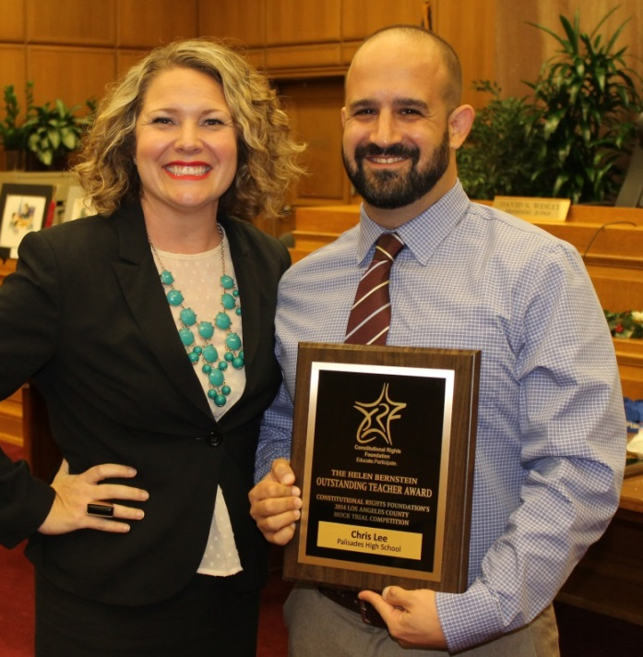
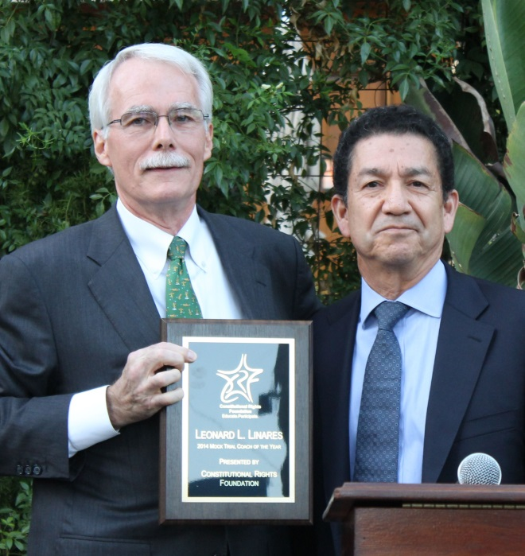
Secure Your Coaches
  Teacher Coaches
  Attorney Coaches
Notes:
After fielding a team, the next thing to do is to secure your coaches—and by that I mean a teacher coach or coaches and, if at all possible, an attorney coach or coaches. Now let me talk for a moment about attorney coaches. First of all, attorney coaches are not necessary for a team to compete in mock trial. The case packet contains all the information your students will need to know to participate in the competition. But most teams participating in the competition will use attorney coaches, at least to some extent. At that’s because attorney coaches can be very valuable in teaching students the rules of evidence, as well as proper courtroom etiquette and trial procedure, so find and use attorneys if you can. If you want an attorney coach but cannot find one on your own, check with your county coordinator for a list of attorneys who may be available to volunteer and help your team.

Slide 4
Read the Entire Case Packet
  Fact situation
  Charges against the Defendant
  Exhibits
  Stipulations
  Witness Statements
  The Simplified Rules of Evidence
  Pretrial materials
  Team Rulebook (separate document)
Notes:
After fielding a team and securing coaches, the next thing your team should do is read the entire case packet. Regardless of role, every team member and coach should start their preparation by reading the case in its entirety. Ideally, you and your team should read the entire case before you assign any roles and before your students begin writing any exams—believe me, in the long run, it will save you a lot of time if everyone reads and understands the whole case before doing anything else. And not only will it save you time--it may avoid the need to recast roles later on. So start by reading the entire case packet. Now, the case packet includes:
-A fact situation outlining the undisputable facts of the case
-A statement of the charges brought against the defendant
-The physical exhibits that may be introduced at trial
-A set of approximately 8 stipulations agreed to by the parties
-A total of 8 witness statements, 4 for prosecution witnesses, 4 for defense witnesses
-The Simplified Rules of Evidence which consists of all the evidentiary objections that can be used by your team during the competition—in other words, students may only use the objections in the simplified rules—if an objection is not listed in the simplified rules, it may not be used during the competition.
-The case packet also includes the Pretrial materials, including additional pretrial facts and case law that can be used during the pretrial arguments. Now, middle school students don’t do pretrial in competition, but high school students do—so the pretrial materials in the case packet are for high school teams only.
-and finally, the case packet includes a separate document entitled Team Rulebook, which outlines all the rules of the competition.

Slide 5
Explain Basic Legal Concepts
  Criminal versus Civil Trial
  Bench versus Jury Trial
  Prosecution versus Defense
  Lay Witness versus Expert Witness
  Presumption of Innocence
  Burden of Proof
  Reasonable Doubt
  Direct versus Circumstantial Evidence
Notes:
After the team reads the case packet, the next thing you should do is make sure your students understand some basic legal concepts—concepts they will need to know as they prepare their case and participate in the competition. All of these basic concepts are explained to some extent in the case packet—you can also google the terms if you need further explanation. The concepts include:
-The difference between a criminal and a civil trial—mock trial is a criminal trial
-The difference between a bench trial and a jury trial—mock trial is a bench trial
-The difference between the prosecution and the defense
-The difference between a lay witness and an expert witness
-The concept of presumption of innocence in a criminal trial
-The burden of proof in a criminal trial
-The concept of reasonable doubt
-And the difference between direct and circumstantial evidence—mock trial uses both forms of evidence
Again, all of these terms are explained in the case packet. You should review each of these terms with your students so that everyone understands the terminology they will hear throughout the competition.

Slide 6
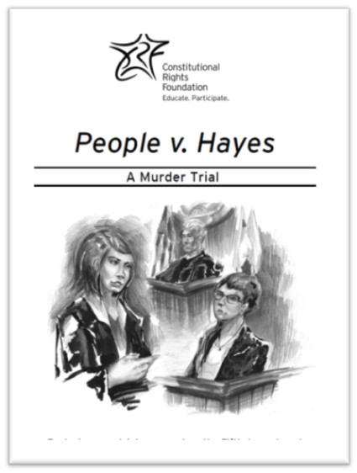
Analyze the Case
Break down Elements of each Charge
Outline the evidence for and against the charge—Look for:
    Forensic evidence
    Eyewitness testimony
    Statements by the defendant
    Motive or lack of motive
    Opportunity, or lack of opportunity, to commit the crime
    Corroboration or Inconsistencies between witnesses
  Decide what witness will testify to this evidence
  Remember: The pretrial ruling may impact what evidence is available
Notes:
After explaining these basic legal concepts to your team, you should, as a team, begin to analyze the case against the Defendant. So, how do you analyze the case? Well, to analyze the case, start by looking at the statement of charges against the defendant, and then break down the elements of each charge. To help you with this, you should review the statement of charges in the case packet, and you should also review the jury instructions in the case packet—the jury instructions explain the charges in greater detail, and they also explain exactly what needs to be proven by the prosecution. After you determine what needs to be proven, outline the evidence for and against each charge. If it helps, prepare a T chart. On one side of your chart, put evidence that supports the charge—that’s the evidence you will need when you are on prosecution, and on the other side of your chart, put evidence that disproves the charge—that’s the evidence you will need when you are on defense. In making your outline or your chart, look at the fact situation, the witness statements, the stipulations and the exhibits, for all of the following kinds of evidence:
-Any Forensic evidence evidencing the defendant’s guilt or innocence—for example, fingerprints, footprints, DNA.
-Look for eyewitness testimony evidencing the defendant’s guilt or innocence
-Look for statements by the defendant evidencing guilt or innocence
-Look for evidence showing the defendant’s motive or lack of motive, or the defendant’s opportunity, or lack of opportunity, to commit the crime
-And, look for corroboration or inconsistencies in the witness statements on key points in the case.
After doing this analysis, next, as a team, decide what witness will testify to each piece of evidence you’ve identified. This step will help your students as they begin writing their examinations because they’ll know exactly what evidence each witness needs to talk about. One last point. When analyzing the case, it’s important that your students understand how the pretrial ruling at trial may impact the evidence that’s available to them during the trial. If the pretrial motion is granted, certain evidence (that is, the information in brackets in the case packet} will be excluded at trial, so your students need to understand how their case may be impacted based on the pretrial ruling, and they need to adjust their case accordingly. Now, for Middle schoolers, because you don’t do pretrial, the bracketed material in the case packet may be used at trial.

Slide 7
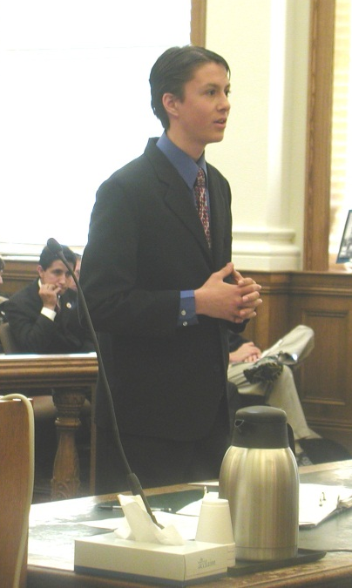
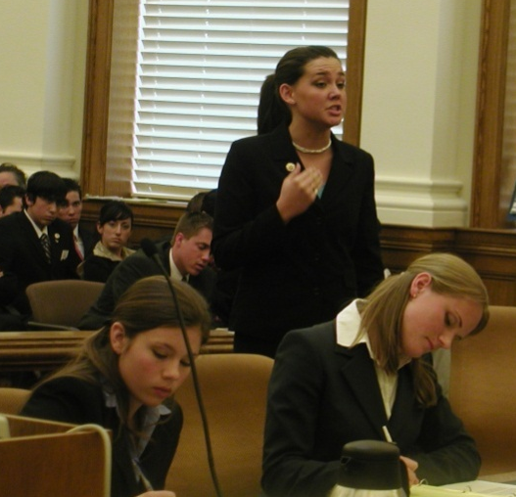
Assign Roles
  Pretrial Attorneys
    For students who are analytical and can “spar” with a judge
  Trial Attorneys
    Decide who will direct/cross each witness, who will open/close
    Balance is important
  Witnesses
    Witness roles are gender neutral
Notes:
After analyzing and understanding your case, you are now ready to assign the roles to the students. Each of the roles are explained in detail in the case packet. Here are some suggestions when assigning roles.
--First, for Pretrial Attorneys, you should assign the pretrial role to students who are very analytical, and who will be comfortable sparring with a judge—a judge who will likely interrupt the student repeatedly during the student’s argument to ask questions. It takes poise and confidence to be a pretrialer, for sure, so assign the pretrial role to students who can handle themselves in that kind of situation.
--For the Trial Attorneys, once you assign this role, you will also need to decide what witnesses each attorney will direct and cross, as well as which attorneys will give the opening statements and closing arguments. In accordance with the mock trial rules, be sure to balance the exams between the trial attorneys, to the extent possible, as imbalances can be reflected in your final team score. For example, under mock trial rules, each trial attorney should conduct at least 1 direct and 1 cross examination, and the openings and closings should be done by different attorneys.
--As for the 8 witness roles, the gender of the student doesn’t matter. All witness roles are gender neutral and can be played by either a male or a female student.

Slide 8
Assign Roles
  Court Clerk
    Long attention span and math skills important
  Bailiff
    Commanding presence
  Unofficial Timekeeper (Optional)
  Suggestion: Allow other students to “shadow” those with roles
Notes:
--As for the Court Clerk role, this role is a perfect role for beginner mock trialers, but it does require a student who has a long attention span and can pay attention during the entire trial. It also requires a student who has some decent math skills, as the clerk will be required to add and subtract time quickly and on command.
--As for the Bailiff role, like the clerk, this role is a perfect role for beginner mock trailers. The Bailiff role is typically assigned to a student with a commanding presence—someone who can take control of the courtroom if and when they need to.
--As for the Unofficial Timekeeper, this role is an entirely optional role and is not required, but assigning this role is a good way to utilize students who otherwise don’t have a role.
And I have one final suggestion in that regard. Consider allowing students who are not assigned a role the ability to “shadow” those who have roles. Allowing student “shadows” not only increases student participation and interest in the case, but also will provide you with some backups in the event you ever have to (for illness or otherwise) recast a role.

Slide 9
Write Direct Examinations—
Purpose and Scope
  Purpose is to establish facts to prove or disprove the case, explore weaknesses in your opponent’s case
  Scope of Directs:
    Limited to information in the witness’s statement or the fact situation/stipulations if witness would reasonably know that information
        Exception: expert witnesses
Notes:
Now, after assigning roles, it’s time for the students to write their case. Students should start by writing the direct examinations. The purpose of direct examination is to establish facts to prove or disprove the case against the defendant, as well as explore the weaknesses in your opponent’s case. Your students will be writing 4 direct examinations on each side, 1 for each witness they will be calling. Under the mock trial rules, each of your direct examinations is somewhat limited in scope. In particular, direct examination testimony is limited to information contained in the witness’s own witness statement or in the fact situation or stipulations if that witness would reasonably know that information. The one exception to this rule is expert witnesses. Expert witnesses are allowed to testify to information in other witness’s statements. But aside from expert witnesses, witnesses may not testify to information contained in other witnesses statements—their directs are limited to information pulled from their own statements. So, use the direct examinations to bring out facts from the witness’s own statement that are helpful to your case. When writing the directs, start by asking the witness some introductory questions (for example, where do you live, what do you do for a living, do you know the defendant, and if so how do you know the defendant?). Then, ask the witness questions that allow the witness to tell a story rather than using leading questions that call for a yes or no answer. For example, these are proper direct examination questions: “Ms. So and so, Do you recall what you were doing on the morning of ___ date? What happened after you saw the defendant drive away? How long were you standing on the corner? What did you do when you went back home? Remember, the purpose of direct examination is to establish facts that will allow you to prove or disprove the case.

Slide 10
Write Direct Examinations—
Time Constraints
  14 minutes total (including re-directs)
  Cut “extraneous” and “objectionable” information
  Refer back to outline of the case to focus testimony
  Important: Allow sufficient time for
    Re-directs
    Approaching exhibits
  Just a Guideline:
      Directs should be between 2 minutes and 4 minutes
      12 minutes for 4 directs; 1 minute for any re-directs; 1 minute buffer
Notes:
Now, as mock trial is a timed competition, there are certain time constraints on the direct examinations. The direct examination, including re-direct examination, of all 4 witnesses on a side is limited to 14 minutes total. I suspect you’ll find that one of the most challenging things for your students when writing their directs will be staying within this timeframe. That’s because the witness statements are full of information, much of it completely extraneous to the case, meaning it will not help you prove or disprove the charges against the defendant, and some of the information is completely objectionable, meaning it will not be accepted into evidence if the other side properly objects to it. To stay within time, and also to avoid sustained objections to your exams, it’s important for your students to CUT the extraneous and objectionable information out of their directs. Also, to stay within time, your students should try to stay focused on why the witness is being called in the first place. To do this, they should refer back to the outline you created as a team on the evidence for and against each charge, and on what witness can testify to this evidence. This will help your students stay focused when writing their direct examinations. Now, as I stated, you only have 14 minutes total for all 4 directs and any re-directs you may want to ask. So, when students are writing their directs, they should allow sufficient time to ask re-direct questions. Also, if they want a witness to approach an exhibit when talking about the exhibit, they will need to allow extra time for the witness to get up and down from the witness stand—time continues to run when they do that. Now, let me give you some guidelines on how to allocate your time during directs. These are just guidelines—your team can allocate your direct time any way you choose. But typically, each direct should be between 2 minutes (on the short end) and 4 minutes (on the long end). Before competition, time your directs, and time your directs often--your 4 directs should be about 12 minutes total; This will allow, at trial, at least 1 minute for any re-directs, and 1 minute as a buffer if your students need extra time to re-ask or rephrase questions or responses, or the attorneys need to ask additional questions in response to objections by the other side.

Slide 11
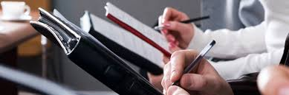
Write Direct Examinations—
Scoring Tips
  DON’T RUN OUT OF TIME!
  Create likeable, credible, interesting witnesses who speak slowly
      Over-the-top versus “realistic” witnesses
      But remember: No accents or costumes!
  Avoid Objectionable Testimony:
      No leading questions
      Witness should be responsive to the question asked
      No long narratives
      Provide foundation for testimony
      Avoid improper hearsay, opinion and character testimony
Notes:
Now, let me now take a moment to give you some scoring tips for direct examinations. First, don’t run out of time in competition. Make sure your students understand that they need to give themselves enough leeway to end all 4 directs before time is called. That’s why I suggest a one minute buffer to cover contingencies. Your team likely will be scored down if you run out of time on your last direct, and if you are unable to even call a witness because your team ran out of time before that witness could be called, scorers are instructed to give your team a 0 for that witness. That’s in effect a 5 point deduction. Believe me, your students can write a really strong, cohesive case even if they cut their directs down to about 12 minutes. Second, students should write the directs in a way that makes their witnesses likeable, credible and interesting, and they should give themselves enough time for both the attorneys and the witnesses to speak slowly so the scorers can understand what they are saying. They will be scored down if they talk too fast. Regarding your witnesses, you will likely see some over the top witnesses in competition. Over the top witnesses can be entertaining, but they are also very risky for scoring purposes. Some scorers will love them, no doubt, but not all scorers will and some scorers may score your team down for not being realistic. And finally, remember, under mock trial rules, no accents or costumes are allowed. Team members must use their normal speaking voices. As for objections, as I mentioned earlier, your students should try to write their directs so that they will avoid sustained objections: For example, they should eliminate leading questions on direct, and make sure the witnesses are responsive to the question asked—meaning they shouldn’t include unnecessary tag-ons to their answers that are completely nonresponsive to the question. Some teams do this to save time, but they risk getting objected to as non-responsive, so it’s just not worth it. Your students should also make sure their witness’s responses are relatively short—that is, no long narratives. And they should provide sufficient foundation for all the questions and responses—that is, establish how the witness would be in a position to know the answer to the question. And finally they should avoid improper hearsay, opinion and character testimony.

Slide 12
Write Cross Examinations—
Purpose and Scope
  Purpose is to explore weaknesses in opponent’s case, test witness’s credibility and establish facts supporting the cross-examiner’s case
  Scope of Crosses:
      Crosses must call for answers based on information in the witness’s own statement
      Mock trial crosses are not limited to issues raised during direct
Notes:
After writing the direct examinations, the students should write their cross examinations. The purpose of cross examination is to explore the weaknesses in your opponent’s case, to test the witness’s credibility, their biases, and to establish a fact for the cross-examiner’s case. Your students will be writing 4 crosses on each side, 1 for each witness on the other side. Like directs, under the mock trial rules, crosses are limited in scope—that is, crosses must call for answers based on information in the opposing witness’s own statement, except for crosses of expert witnesses. However, unlike real trial, mock trial crosses are not limited to issues raised during the directs. So, even if an opposing witness does not discuss an issue on their own direct examination, student attorneys may explore that issue during their cross examination of that witness.

Slide 13
Write Cross Examinations—
Time Constraints
  10 minutes total, or an average of 2 ½ minutes each
        Typically, ask between 10 and 25 questions
        Typically, the cross of the defendant is the longest
  Allow extra time for non-responsive witnesses, and for expert witnesses who have leeway to explain answers
Notes:
Now, let’s talk for a minute about the time constraints for crosses: Teams only have 10 minutes total for all 4 cross exams, or an average of 2 ½ minutes each. That’s not a lot of time. Typically, cross examinations in mock trial are anywhere between 10 and 25 questions each. That doesn’t mean all of the crosses can be 25 questions long—some should be shorter, otherwise you probably will not have enough time to complete all 4 crosses within time. Typically, the cross examination of the defendant is the longest cross examination because, not surprisingly, it has the most material to cover. When students are writing and timing their cross examinations, they should allow some extra time to cover the possibility that they will be crossing a non-responsive witness and therefore will need to add or re-ask questions to that non-responsive witness. Your students should also be prepared at trial to cut out questions they would normally ask on cross if they are confronted with a non-responsive or difficult witness who is taking a lot of their time. In other words, before competition, your students need to prioritize what they have to get out on cross, and what they can cut if they are running out of time at trial. Finally, students should allow some extra time when crossing expert witnesses, as expert witnesses are often allowed leeway by the court in answering questions and explaining their answers.

Slide 14
Write Cross Examinations—
Scoring Tips
  Use leading questions designed to get a yes or no answer
  Make 3 or 4 points and sit down!
Notes:
Now let’s turn to some scoring tips for cross. As a general rule, your crosses should use leading questions that are designed to get a yes or no answer from the witness. It’s risky to ask open-ended questions on cross examination because you can loose control of your witness really easily. The key to effective cross examination is controlling your witness and keeping the witness on track by asking questions that call for a yes or no answer. So, examples of proper cross examination questions are: Isn’t it true that ____. You would agree that ______. You didn’t actually see the defendant, did you? Second, because your cross time is so short, students should try to limit their crosses to making 3 or 4 points for your case (giving yourself 5 or so questions to make each point), and then the students should sit down. Students won’t have time for much more than that.

Slide 15
  Write Re-direct Examinations
  The purpose of redirects is to clarify or explain bad or confusing cross testimony
  Suggestion: Write 3 or 4 re-direct questions for possible use during the trial
  Remember: Redirects are limited in scope to what is raised on cross examination
Notes:
After writing their cross examinations, students should then write some re-direct examination questions. The purpose of the redirects is to clarify or explain bad or confusing cross testimony. It’s a way to re-habilitate your witness. Here’s my suggestion for re-directs: Before the competition, students should draft 3 or 4 re-direct questions for possible use during the trial. In drafting these redirects, students should anticipate what will likely happen on cross examination. Of course, students don’t have to use any of their pre-scripted redirects during competition, and further, they shouldn’t limit themselves to pre-scripted re-directs during the competition. Redirects are limited in scope to what is actually raised on cross examination, so some of your pre-scripted re-directs may not be usable or appropriate and your trial attorneys should be prepared to improvise re-directs if necessary.

Slide 16
  Write Opening Statements:
  Typically 3 to 4 minutes long
  The opening is a short, concise statement of the case, not an argument! Use terms like—
        The evidence will show
        You will hear
        You will learn
        You will find
        ____ witness will testify
Notes:
After students write their examinations and therefore know the evidence they will be eliciting, they will now be in a position to write their opening. Typically, openings are between 3 and 4 minutes long. The opening is a short, concise statement of the case, not an argument! So, in writing their opening, students should use terms like—
The evidence will show
You will hear
You will learn
You will find
Such and such witness will testify

Slide 17
Write Opening Statements—
Structure
  Prosecution Opening Structure:
      Explain what you intend to prove and how you will prove it
      Present events in an orderly sequence
      Suggest motive, describe opportunity
      Tell your story!
  Defense Opening Structure:
      Remember—You do not have the burden of proof!
      The purpose is to explain the weaknesses in the prosecution’s case, and why there will be reasonable doubt
Notes:
Mock Trial Openings tend to follow a certain structure. They don’t have to follow this structure, but let me tell you what is typical in competition. In the Prosecution Opening, students will explain what they intend to prove and how they will prove it. When doing so, they will present events in an orderly sequence, something the scorers can understand and follow easily. If they can, students will also want to suggest a motive and explain the defendant’s opportunity to commit the crime. The prosecution opening is your team’s chance to tell your story as to why the defendant will be found guilty at the end of the trial! As for the Defense Opening, it’s important to remember that the Defense does not have the burden of proof—the prosecution does. The purpose of the Defense Opening is to point out the weaknesses in the prosecution’s case, and to explain why there will be reasonable doubt of the defendant’s guilt at the end of the trial.

Slide 18
Write Opening Statements—
Scoring Tips
  Mention the name of each witness you will be calling and provide some insight (even if very brief) into what that witness will be testifying about
  Use a Theme. Examples:
      Prosecution:
        This case is about a defendant who couldn’t control his anger
        The defendant’s greed got the better of him
        This case is about a defendant who is pretending to be insane to avoid taking responsibility for his own actions
      Defense:
        The case is based on witnesses who could not see, and an investigator who did not look
        This case is about mistaken identity
        This case is about a student who acted out of self-defense
Notes:
Now for some scoring tips for the openings. When writing the openings, your students should consider mentioning the name of each witness they will be calling in the case and providing some insight (even if very brief) into what that witness will be testifying about. You’ll find this may help the scorers follow your case better during the course of the trial, and that should help your score. Second, to make your Opening more memorable, students should consider using a theme in their opening, and possibly repeating that theme throughout the case, including the closing. Some examples of themes are:
For the Prosecution:
This case is about a defendant who couldn’t control his anger
The defendant’s greed got the better of him
This case is about a defendant who is pretending to be insane to avoid taking responsibility for his own actions
For the Defense:
This case is based on witnesses who could not see, and an investigator who did not look
This case is about mistaken identity
This case is about a student who acted out of self-defense
These are examples of themes—they may not be applicable to this case, but they are examples of the kind of themes that are appropriate for mock trial.

Slide 19
Write Closing Arguments
  Typically, closings are 5 1/2 to 6 minutes long (depending on the Opening)
  Unlike the opening, the closing is an argument!
Notes:
After writing the openings, students can turn to writing the closings. Typically, closings are 5 1/2 to 6 minutes long (depending on the time of the Opening). Remember, you have 9 minutes total for both the opening and the closing, excluding the rebuttal. So if you have a long opening, your closing will need to be shorter. But given that the closing is double scored, and that there is so much more evidence and testimony to cover in the closing compared to the opening, typically the closing is at least 5 ½ minutes long. Unlike the opening, the closing is an argument! Closers present a persuasive argument as to why the Prosecution has proven, or not proven, its case against the defendant beyond a reasonable doubt.

Slide 20
Write Closing Arguments—
Structure
  Prosecution Closing:
      The Prosecution has the burden of proof
      Walk through the charges and explain proof
        Be specific!
        Explain motive and opportunity
  Defense Closing:
      No burden of proof!
      Walk through the charges and explain reasonable doubt
        Be specific!
        If applicable, discuss other reasonable suspects
Notes:
Let’s talk about the typical structure of a mock trial closing. Again, you don’t have to follow this structure, but it’s what you can expect to hear from many teams during the competition. As for the Prosecution Closing, the Prosecution has the burden of proof—they must prove the defendant’s guilt beyond a reasonable doubt. So in writing your prosecution closing, students should start by walking through the charges against the defendant and explaining how each element of the charge has been proven beyond a reasonable doubt. It’s important for the students to be specific! They need to cite the evidence and witness testimony that proves each charge. If they can, students should explain the defendant’s motive to commit the crime, as well as the Defendant’s opportunity. For the Defense closing, remember, the defense has no burden of proof! In other words, the Defense doesn’t (and shouldn’t) argue that the defendant is innocent. Instead, students should explain why the prosecution has failed to meet its burden and prove guilt beyond a reasonable doubt. In the defense closing, students should walk through each of the charges against the defendant and explain why there is reasonable doubt as to each charge. Again, students should be specific! They should cite the evidence and witness testimony that raises reasonable doubt. If applicable, they can also discuss other reasonable suspects discussed during the trial.

Slide 21
Writing Closing Arguments—
Scoring Tip
  Be flexible!
  Adjust argument based on the evidence
Notes:
As for scoring tips for the closings, the most important thing is for the closers to be flexible! For one thing, closings may only reference evidence presented and accepted during the trial—no new facts can be argued, and no objectionable testimony can be referenced. Therefore, at trial, closers need to adjust their closing argument based on the evidence that was accepted by the court during the trial. So for example, if opposing counsel successfully objects to a piece of your evidence, or if under the pretrial ruling certain evidence is excluded from the trial, your student may not cite to that evidence in the closing. Similarly, if your team is able to impeach a witness during trial, particularly the defendant, it can help your closer’s score if your closer improvises by making reference to that impeachment during the closing and arguing that the witness is not credible. The bottom line is that, generally speaking, closers score best when they can adjust their argument to what actually happens during the trial, rather than merely reciting a pre-scripted closing argument.

Slide 22
Write Closing Rebuttals
  1 minute for each
  The purpose is to respond to your opponent’s closing arguments
  Scoring Tips:
      Don’t go in cold!
      Practice beforehand
      Don’t run out of time!
Notes:
After writing your closing arguments, students should write some closing rebuttals. At trial, your closing rebuttal will be just 1 minute long. The purpose of the closing rebuttal is to respond to your opponent’s closing arguments. The purpose is not to simply re-hash arguments already made, particularly when they are uncontested. However, for scoring purposes, students shouldn’t go in to the rebuttal cold! Before and during the trial, your closer should anticipate arguments that likely will be raised during your opponent’s closing, and formulate in advance some things the closer might want to say during rebuttal. Also, since it will be improvised to some extent, your closer should practice what a 1 minute response feels like—1 minute is very short, but practicing will help ensure the student doesn’t run out of time. Finally, the last thing your closer will want to do is run out of time on the rebuttal. Time being called is the very last thing the scorers will hear before scoring the closing. The reality is, a student can have an amazing closing and be docked simply because the student ran out of time on the rebuttal. So be sure your closer ends the rebuttal before time is called.

Slide 23
Pretrial—
Getting Prepared
  High School Only
  Review fundamental concepts:
      What is stare decisis?
      What rulings trump others?
      What is a holding? What is dicta?
      How is the Constitution applicable to this case?
      What is the role of the Judge and pretrialer in the pretrial argument?
Notes:
Let’s now talk about Pretrial. First of all, Pretrial is for high school students only. Middle school mock students do not do pretrial. So for you high school mock trial coaches, when preparing for pretrial, you should start by reviewing some fundamental concepts with the pretrialers. For example:
What is stare decisis?
What rulings trump other rulings?
What is a holding? What is dicta?
How is the Constitution applicable to this case (that is, what is the interplay of the 14th Amendment).
What is the role of the Judge and the pretrialer in the pretrial argument

Slide 24
Pretrial—
Getting Prepared
  Read the cases
      Important: Don’t go beyond the abbreviated cases
      The holdings and facts may have been changed deliberately
Notes:
Next, to prepare for pretrial, the coach and student pretrialers will need to read the cases in the case packet. In this regard, it’s very important to remember that under mock trial rules, pretrialers are limited to talking about the caselaw in the case packet—they cannot go beyond the abbreviated cases in their argument. In addition, it’s very possible that the holdings and facts in the case may have been changed deliberately from real case law. So read and interpret the cases as they are described in the case packet, and don’t extrapolate based on what the “real law” may be.

Slide 25
Pretrial—
Getting Prepared
  Analyze the cases
    For each case, identify the holding and facts in support
    Determine which side the holding helps and hurts
          If good for your side, you may want to use that case to support your argument
          If bad for your side, you will need to distinguish the case based on its facts
Notes:
After reading each of the cases, begin analyzing them. Start by identifying the holding in each case and the facts supporting the holding. Then, determine whether the holding is good for the prosecution, good for the defense, good for both the prosecution and the defense, or not good or bad for either side. If the holding is good for your side, you may want to use that case to support your argument. If the holding is bad for your side, you will need to distinguish the case based on its facts.

Slide 26
Pretrial—
Getting Prepared
  Write your Pretrial Argument
    Keep in mind time constraints
          4 minutes for Opening
          2 minutes for Rebuttal
  Create Opening Argument citing 3 to 4 cases that support it
  Start with an introduction, state your argument, then cite case law, then conclude
Notes:
After analyzing the cases in the case packet, students should begin to write their pretrial argument. When doing so, it’s important to keep in mind the time constraints for the pretrial argument. Pretrialers have 4 minutes for their Opening argument, and 2 minutes for their rebuttal argument. In creating your Opening arguments, students should try to cite 3 to 4 cases supporting their position. They should start their Opening argument with an introduction, then state their argument, then go through each argument by citing case law, and then conclude.

Slide 27
Pretrial—
Getting Prepared
  Rebuttal:
        Don’t go in cold! Anticipate the main arguments on the other side
        Listen to what the other side says and only counter what the other side said
        Practice ending rebuttal before time is called
Notes:
Let’s now talk about the Pretrial Rebuttal. Like the closing rebuttal, it’s best not to go into the pretrial rebuttal cold. Before competition, pretrialers should write out some rebuttals for possible use during the trial. In doing this, they should anticipate the main arguments on the other side and prepare a response to each of those arguments. Then, during the actual trial, they should listen to what the other side says and only counter what the other side says, even if the Pretrialer has prepared responses to other arguments. Because your rebuttal will not be entirely scripted, students should practice ending their rebuttal before time can be called.

Slide 28
Pretrial—
Scoring Tips
  The key to pretrial is practice!
  Avoid repeating your arguments
Notes:
I have some scoring tips for Pretrial. First, the key to pretrial is practice! Pretrialers should practice with a coach one on one, to the extent possible. They should practice answering questions about their argument, and they should practice getting interrupted during their argument and getting back to where they left off before they were interrupted. As a general guideline, it’s highly recommended that students practice one on one with a coach for 25 hours or more prior to competition. And second, Pretrialers should avoid repeating their pretrial arguments. If the judge asks the Pretrialer a question and the Pretrialer answers the question, the Pretrialer shouldn’t simply repeat that same answer verbatim when delivering their argument. At the very least, the Pretrialer should say it differently, or even better, make another argument, but they should not repeat their words verbatim.

Slide 29
Practices—
What to Do at Team Practices
      Understand courtroom and the order of trial
      Analyze the case, develop theories and themes
      Write and practice directs
      Practice cross examinations on witnesses
      Review the Rules of the Competition
      Practice introductions
      Research expert opinions
      Monitor and review any errata issued in the case
Notes:
Let’s move on to what to do during Practices. Let’s start with Team practices. Here’s a list of things to do, in no particular order. Number one, make sure students are comfortable with the layout of a courtroom and that they understand what to expect during the trial, including the order of the proceedings. To do this, you can review the courtroom diagram contained in the case packet. You can also watch the DVDs of the prior state mock trial final rounds. Your team, including the coaches, will learn a lot about the mock trial competition by watching these DVDs. The DVDs are available for purchase at the CRF website. Watch them, study them, learn from them if you can. Use them as a tool for students to become more acquainted with what the competition will feel and look like, to avoid surprises. Number two thing to do at team practices: Prepare your analysis of the case, meaning develop, as a team, your case theories and themes, and also determine what witness will be testifying to each piece of evidence you will be presenting at trial. Remember: You should do this analysis before your students begin writing anything! Number 3: During team practices, students should write and practice their direct examinations. To save time with directs, have your trial attorney and witness pairs team up and work together on writing their directs. That way, all eight directs will be completed in relatively short order. Number 4: At team practices have the trial attorneys practice their cross examinations on the witnesses. The attorneys and witnesses will be together, so use the time to cross and respond to each other. Number 5: Review the Rules of the Competition with the team. Every member of the team should be familiar with the rules of the competition so that they don’t inadvertently violate the rules and hurt the team’s overall score. Number 6. Practice Introductions as a team. During competition, teams introduce themselves at the beginning of each trial, and although the introduction are not separately scored, those introductions matter—it’s the scorer’s first impression of the team, so practice the introductions. Number 7: To fully understand the expert opinions, it may be helpful to do some outside research. Although teams cannot go outside the case packet in their testimony, outside research can be helpful in fully understanding the expert’s statement and opinions. Number 8. At team practices, monitor and review any Errata issued by CRF, and make any changes you need to to your case. Erratas are issued if CRF wants to make a change or clarification in the case, so be on the look out for Erratas—your team will be bound by them. Erratas will be posted on the CRF website and on their Facebook page.

Slide 30
Practices—
What to Do at Trial Attorney Practices
  Review the Rules of Evidence.
  Review the Witness Statements and your Direct and Cross Examinations and then:
        Determine what is objectionable
        Practice how to respond to any objections to your exams, and how to make objections to the other side’s exams.
  Review the Rules of the Competition
        Learn when to make rule violation objections
        Practice how to respond to rule violation objections
  Develop Cross examinations
  Learn how to Impeach Witnesses
  Learn how to control Witnesses
  Learn how to enter Exhibits
  Create Opening and Closing statements
  Draft Preliminary Matters
Notes:
Let’s move on to trial attorney practices. Ideally, you should try to schedule separate practices between the coach and the trial attorneys only. You can certainly work with the trial attorneys at team practices, but it may be helpful to schedule separate trial attorney practices so you can focus on the things that the trial attorneys in particular need to know. Here are some ideas on what you can do at trial attorney practices: Number 1: Review the Simplified Rules of Evidence and discuss what kind of evidence is deemed objectionable under the rules. Number 2. Review the Witness Statements and the Direct and Cross Examinations you’ve drafted and then determine if anything in them is objectionable; if there is something that is objectionable, practice how to respond to it, as well as how to object to it if the other side tries to elicit that evidence. Number 3. Review the Rules of the Competition and determine when to make rule violation objections and how to respond to rule violation objections that may be made against your team. Number 4: Write and practice the cross examinations. Number 5: Learn how to Impeach Witnesses—students don’t have a lot of time in competition to impeach witnesses, so they need to learn how to do it quickly but effectively. Number 6: Learn how to control a non-responsive witness on cross examination. Students need to learn how to control witnesses; otherwise non-responsive witnesses will cause your team to run out of time. Number 7: Learn how to enter exhibits into evidence, and review your examinations to ensure it is done properly. Number 8: After writing the directs and crosses, and knowing what evidence they will be eliciting, students should write their opening and closing statements and rebuttals. Number 9: students should consider drafting some preliminary matters to address with the court before trial--For example, asking the court for permission to move freely around the courtroom, and to approach exhibits. Having some preliminary matters to address with the court before trial, if they are done well, can put the attorneys in a positive light with the scorers before the trial even begins.

Slide 31
Practices—
What to Do at Witness Practices
  Develop “character” for direct examination
  Prepare for Cross
        Know your statement!
        Know what you cannot say (what is objectionable)
        Remember: Running the other team’s time is not allowed
Notes:
Let’s talk about Witness Practices. Separate witness practices are not necessary, but can be helpful if your team has the time. There are a few things students can work on with their coaches during witness only practices. For example, students can develop the witness’s “character” for direct examination. Again, think about what will make the witness likeable, credible, and interesting. All of those qualities may increase the witness’s score during competition. During witness practices, witnesses can also prepare for Cross Examination—in preparing for cross, witnesses should consider all possible cross topics that may be covered by other teams and then prepare responses to those cross topics. In doing cross prep, witnesses should know his or her statement inside and out! In preparing for cross exam, witnesses should also understand what they cannot talk about during cross—that is, what information from their witness statements is objectionable and should not be offered by the witness in response to a cross question. Finally, it’s important for witnesses to remember that the running of the other team’s time is not allowed under mock trial rules. So witnesses should learn how to reasonably respond to questions without running the other side’s time.

Slide 32
Scrimmages
  Optional but can be Helpful
  Benefits of Scrimmaging—
      Increase understanding of mock trial competition
      Learn strengths and weaknesses of your case
      Fun opportunity to meet other teams!
  Check out CRF website for list of teams
Notes:
Finally, let’s talk about scrimmages. Before the competition, some teams will set up scrimmages with other teams so that they can do a run through of their case. Scheduling scrimmages with other teams before the competition is entirely optional, but it can be very helpful. What are the benefits of scrimmaging? For one, scrimmaging can increase your student’s understanding of what to expect during the mock trial competition. It’s also a really good way to learn about the strengths and weaknesses of your case before you present your case in competition. By scrimmaging, teams will learn what works and what doesn’t work in their case, and they’ll then have time to change what doesn’t work. Scrimmaging is also a great, fun opportunity for students to meet students on other teams! If you’re interested in scrimmaging other teams, check out the CRF website for a list of teams that may be available to scrimmage.

